Slide 1


Predicting the Mechanical Properties of Complex Lattice Metamaterials Using Graph Neural Networks (GNNs)
Alexander Adamsª, Helder Rebelo^{b}, Dr. Xing Liu^{b} (Advisor)
ª Department of Mechanical Engineering and Materials Science, University of Pittsburgh, Pittsburgh, PA 15260
^{b} Department of Mechanical and Industrial Engineering, New Jersey Institute of Technology, Newark, NJ 07102

Slide 2
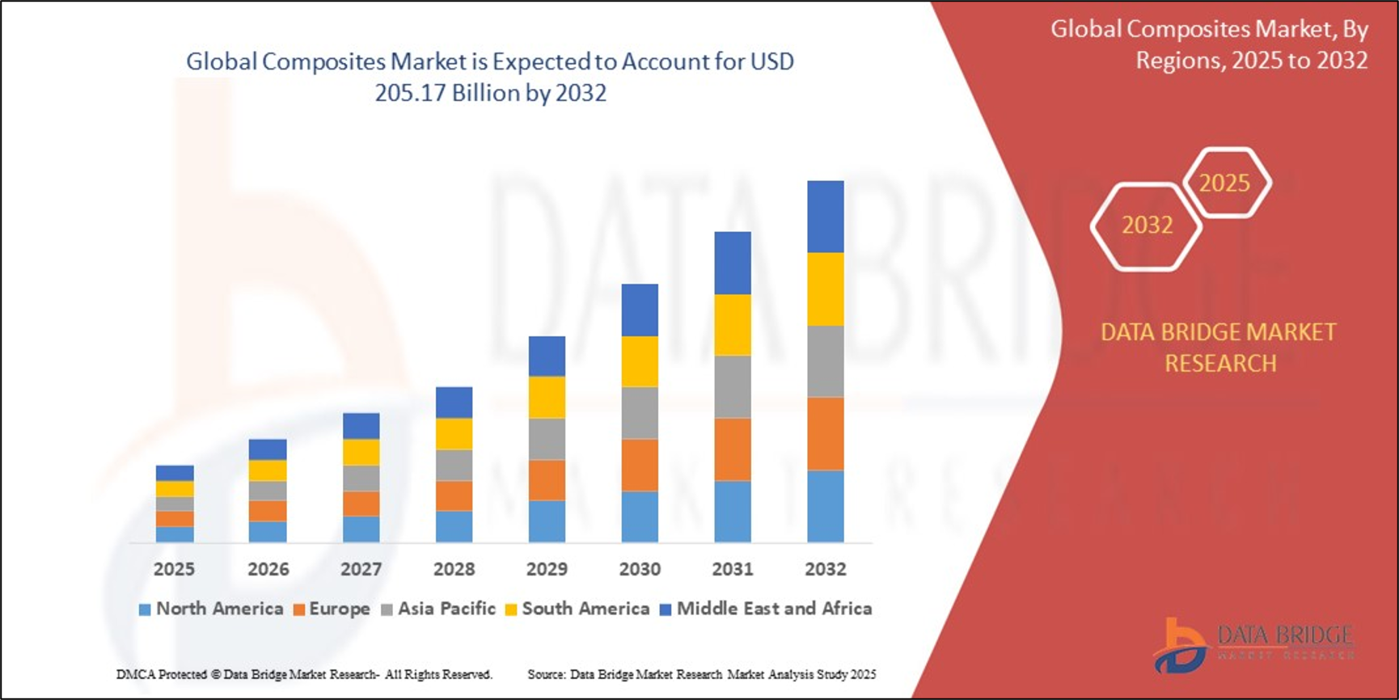


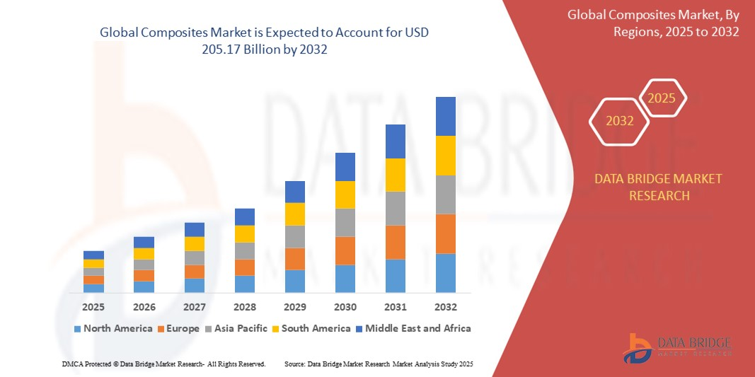
ECONOMICS OF ADVANCED MATERIALS
$1.2T+
Global advanced materials market (2023)
$110–133B → $205–313B
Architected composites & lattice materials, 2024 → 2032–34 (~8–9% CAGR)
30–50% / 40%+
Stiffness-to-weight gain over foams / possible weight reduction from lattice design

Slide 3
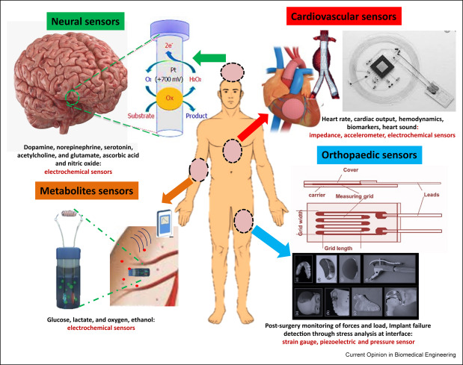
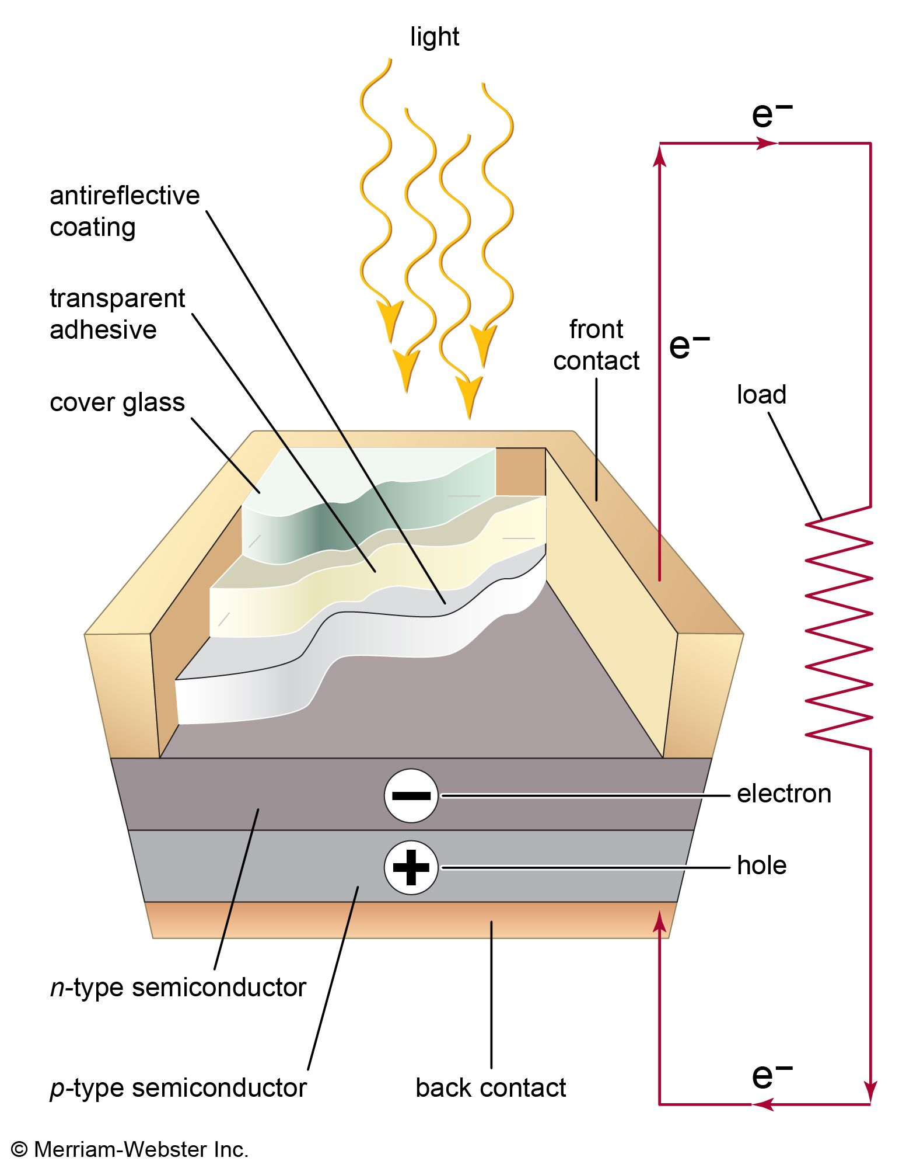
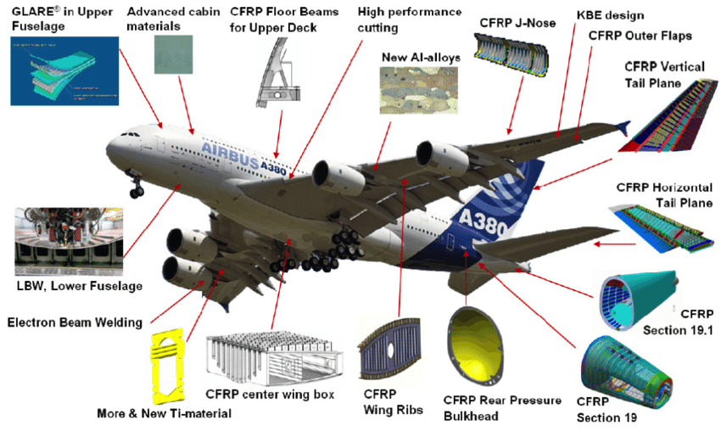
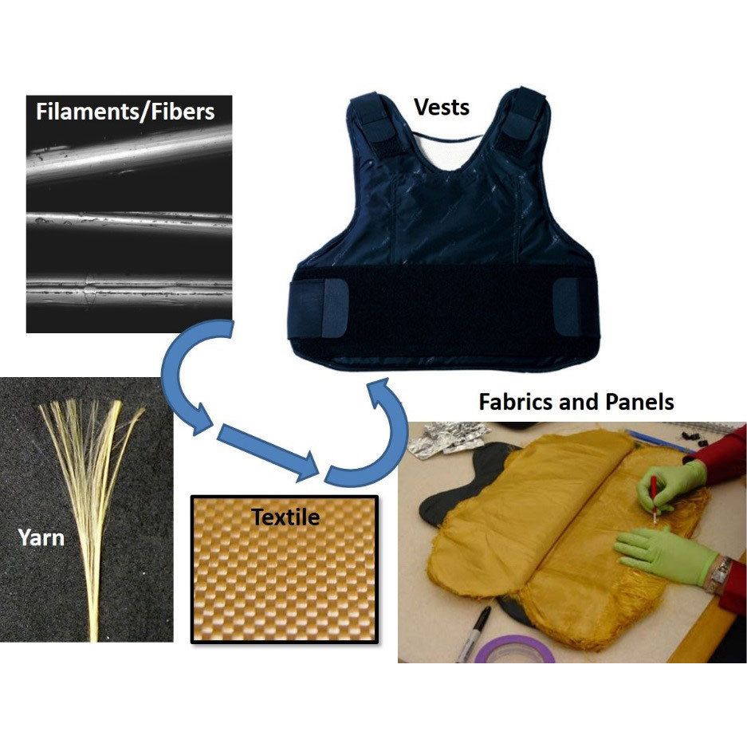
The Materials Ceiling
Every high-stakes field runs into the same wall no matter how urgent the mission
Medicine
Energy
Aerospace
Defense
Neurodegenerative drug carriers and implants are only as good as the material that holds them together.
Battery density and solar efficiency stall without lighter, stronger structural and storage materials.
Every efficiency gain in flight is a materials problem before it is ever an aerodynamics problem.
Protection-to-weight ratio is dictated by the material itself, not by the mission built around it.
Notes:
Alzheimer’s therapeutics. Clean energy. Hypersonic flight. Every one of them stalls at the same wall what materials can actually do. This project is built to move that wall. $1.2T+ global advanced materials market underwrites all four — this is not a niche problem.

Slide 4
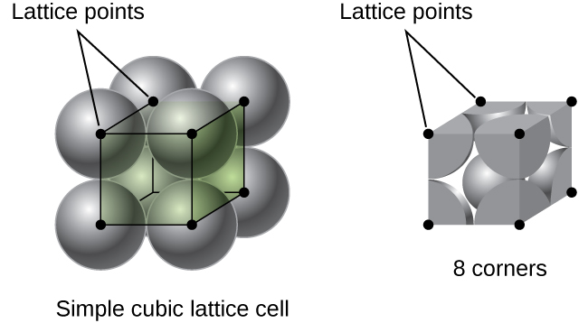

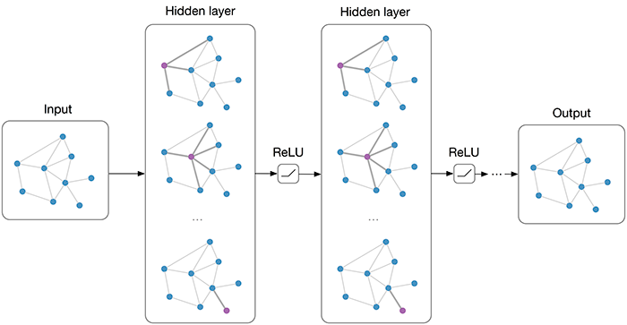
The Problem
Theory assumes perfectly periodic lattices; reality introduces feature variance; classical models fail to predict real behavior.
Computational physics solvers are both time and resource intensive
Project Goal
Build a graph neural network that predicts lattice stiffness directly from imperfect, real-world geometry, fast enough for iterative design, accurate enough to trust in place of full simulation.

Slide 5
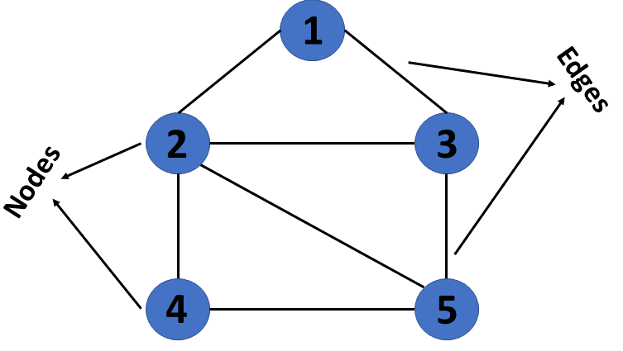
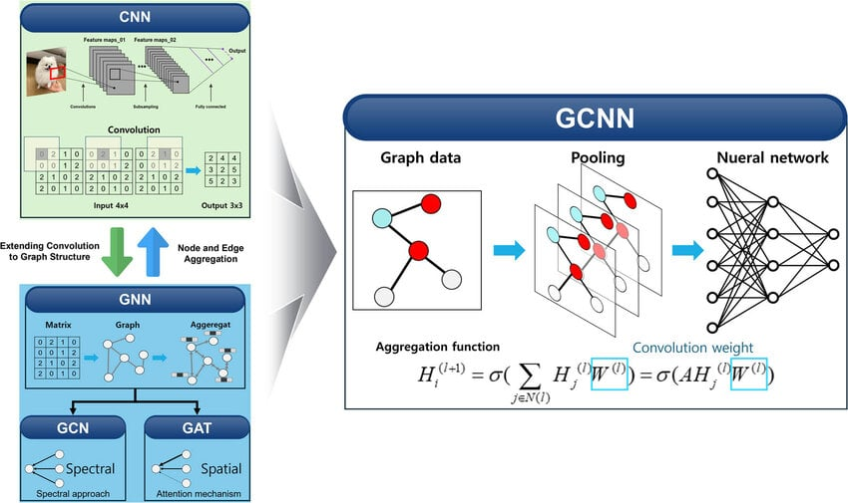
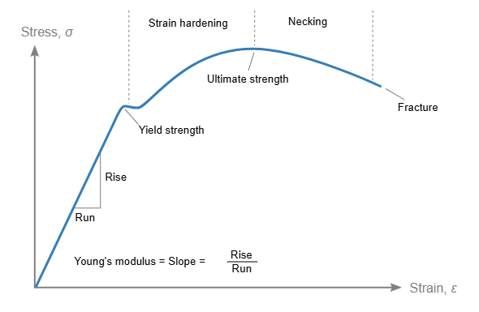
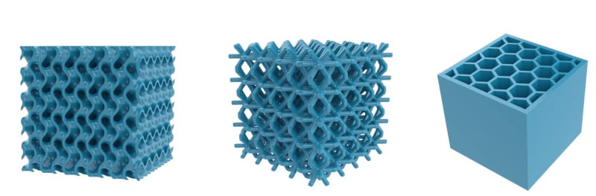
Research Approach
A graph neural network learns directly on lattice geometry, no meshing or billions of degrees of freedom
Lattice Geometry
Graph Construction
GCN Model
Predicted Stiffness
▸
▸
▸
3000 Vornoi-Lattice Samples Were Generated using Abaqus (FEA Software)
Lattice Samples Represented as a graph through the use of the lab’s python script
Neural network trained on the graph inputs, continually optimized based on prior performance
GCN will be able to predict the stiffness of a given material based on its lattice structure
Notes:
Graph: In mathematics and computer science, a graph is a collection of nodes connected by edges. Node: Represents a joint where lattice beams meet. Edge: Represents a beam connecting two joints. Graph Neural Network: Learns by allowing neighboring nodes to repeatedly exchange information. Feature: Information describing the geometry, such as position, connectivity, or whether a node is on the boundary.

Slide 6
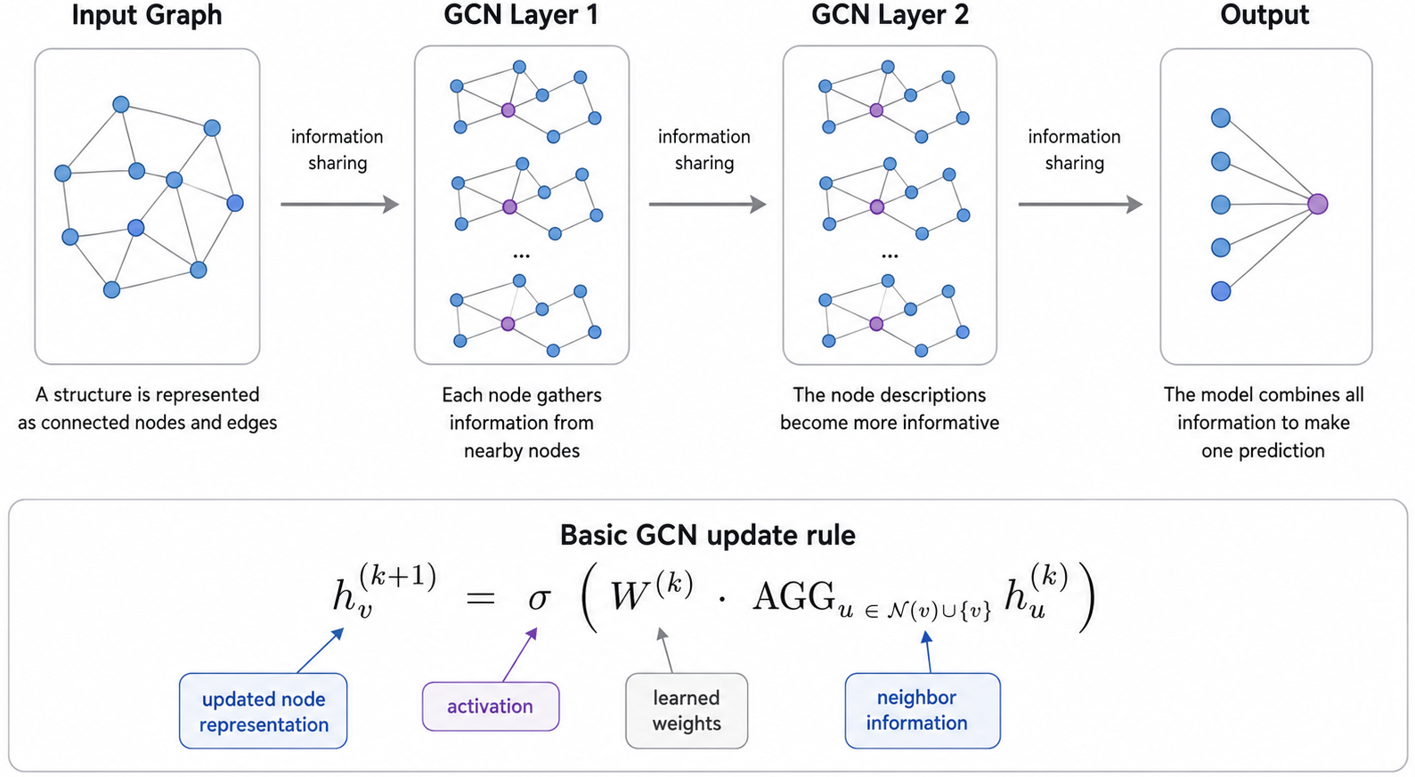
Notes:
Graph: In mathematics and computer science, a graph is a collection of nodes connected by edges. Node: Represents a joint where lattice beams meet. Edge: Represents a beam connecting two joints. Graph Neural Network: Learns by allowing neighboring nodes to repeatedly exchange information. Feature: Information describing the geometry, such as position, connectivity, or whether a node is on the boundary.

Slide 7
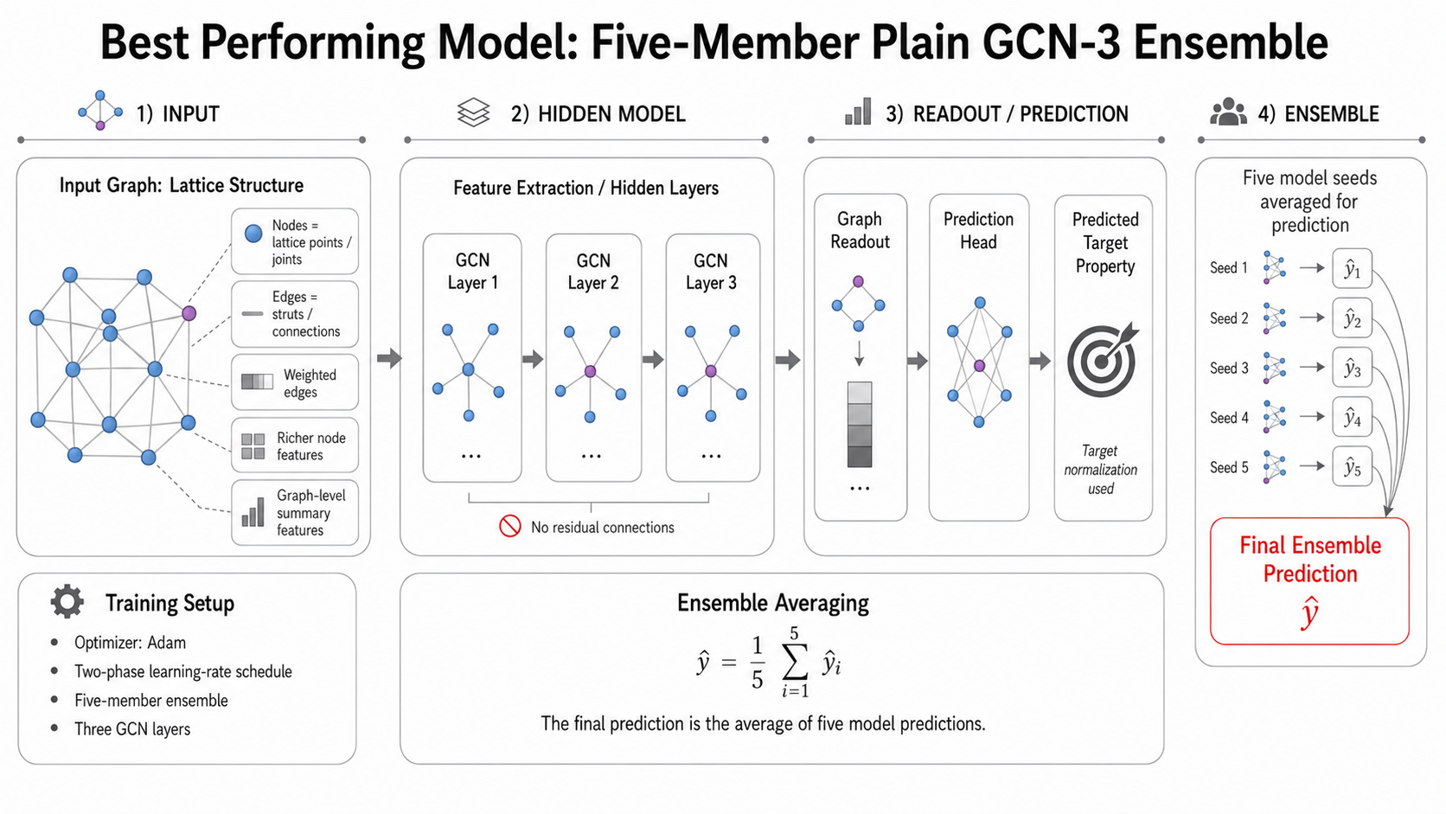
Notes:
Graph: In mathematics and computer science, a graph is a collection of nodes connected by edges. Node: Represents a joint where lattice beams meet. Edge: Represents a beam connecting two joints. Graph Neural Network: Learns by allowing neighboring nodes to repeatedly exchange information. Feature: Information describing the geometry, such as position, connectivity, or whether a node is on the boundary.

Slide 8
Results
Representation upgrades (not optimizer tuning) drove the accuracy gain
R²: 0.9148 → 0.9456
Baseline vs. best multi-seed configuration
RMSE: 0.00382 → 0.00288 (−24%)
Validated Across 5 Seeds
Test R² range: 0.934 – 0.955
Adam remains the strongest optimizer (AdamW and SGD variants underperform)
GCN-3 modestly outperforms GCN-2; GraphSAGE and GIN did not improve results
Open question: out-of-distribution (prediction-set) generalization still trails held-out test accuracy, focus of ongoing work.
Notes:
R² (R-squared): Measures how closely predictions match the true values. Values closer to 1 indicate better performance. RMSE (Root Mean Square Error): Measures the average prediction error. Smaller values are better. Baseline: The original model used as the starting point for comparison. Emphasize that improvements came from better representing the lattice, not simply changing training settings.

Slide 9
Discussion & Future Work
Where this stands
THE BIGGER PICTURE
A fast, defect-aware GCN surrogate now predicts lattice stiffness at 0.95 test R², replacing costly FE simulation and enabling rapid design iteration across defective, real-world lattice geometries.
Materials set the ceiling for aerospace, energy, medicine, and defense alike. Faster, defect-aware design tools push that ceiling higher across a $1.2T+ market moving toward $200–300B+ in architected materials alone.
Next steps
Multi-seed validation of Huber-loss objective for tail-seed stability
Stabilize residual GCN-3 to close the out-of-distribution gap
Extend beyond stiffness to failure-mode / fracture prediction
ACKNOWLEDGEMENT
Dr. Xing Liu
Dept. of Mechanical & Industrial Engineering, NJIT
Computational Mechanics & Physics Lab
Dept. of Mechanical & Industrial Engineering, NJIT
NSF REU Site: Optics & Photonics
New Jersey Institute of Technology, Summer 2026
Notes:
ADD HELDER NAME ADD SLIDE FOR GCN ADD METRICS GOING OVER # OF SIMULATIONS RAN (3K)

